Slide 1
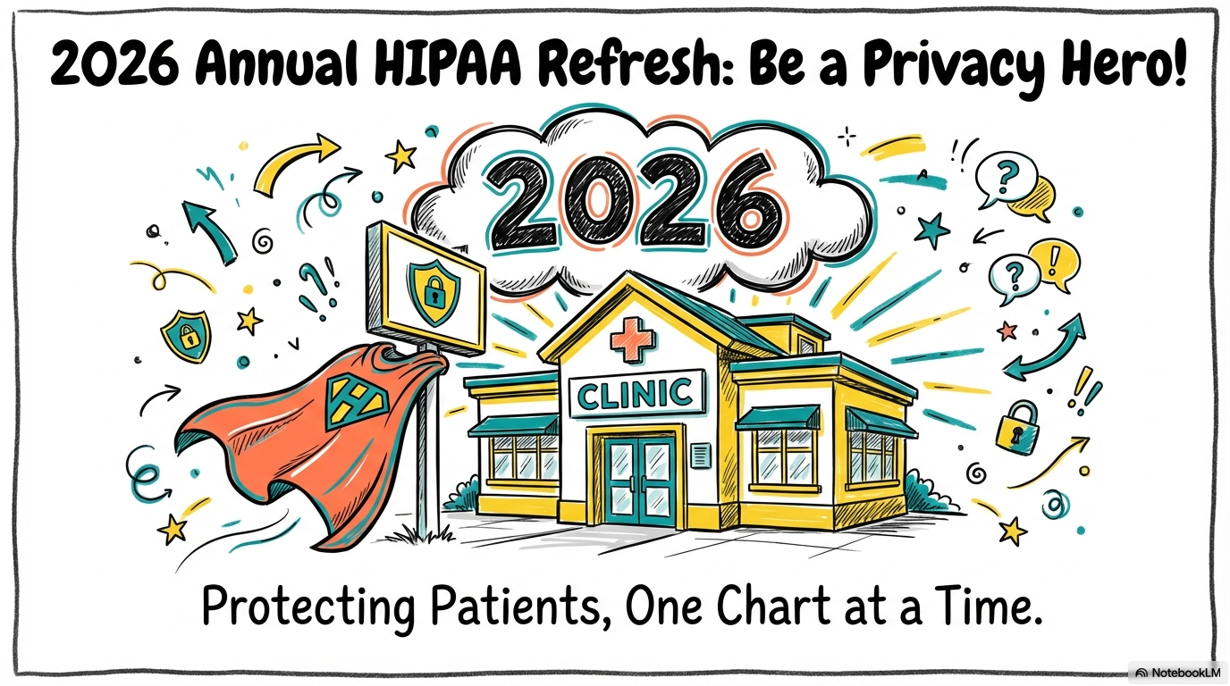





Notes:
Hi everyone! Welcome to your 2026 Annual hipaa Refresher. I’m so glad you’re here. This year, we’re doing things a little differently, we’re not just talking about rules; we’re talking about how each and every one of you is a Privacy Hero for our patients. Our mission is simple: Protecting patients, one chart at a time.

Slide 2
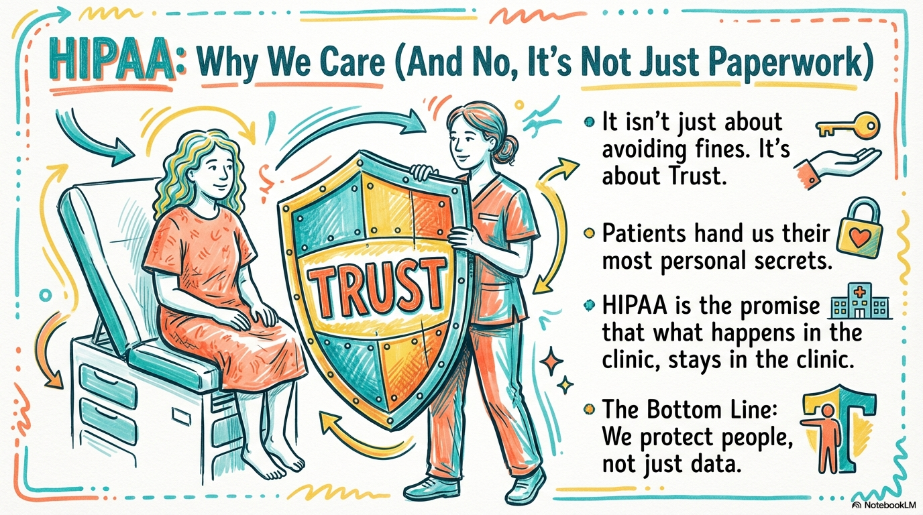
Notes:
Now, I know what some of you are thinking: 'Another hipaa training? Isn't this just more paperwork?' But it’s actually about something much bigger, it’s about Trust. Patients hand us their most personal secrets, and hipaa is our promise that what happens in this clinic, stays in this clinic. At the end of the day, we protect people, not just data.

Slide 3
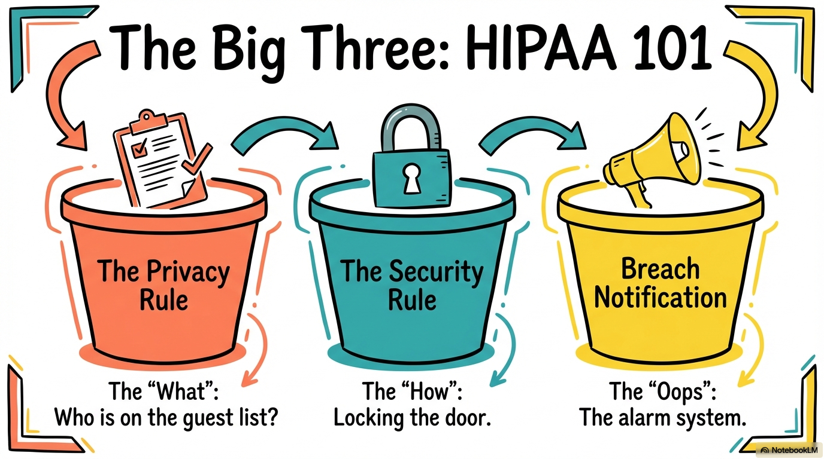

Notes:
Let's look at our 'Big Three' buckets of compliance.
First, the Privacy Rule—think of this as the 'What.' Who exactly is on the guest list to see patient info?
Second, the Security Rule—that’s the 'How.' This is like locking the front door to keep the data safe.
Finally, Breach Notification—the 'Oops.' This is our alarm system if something goes wrong.

Slide 4
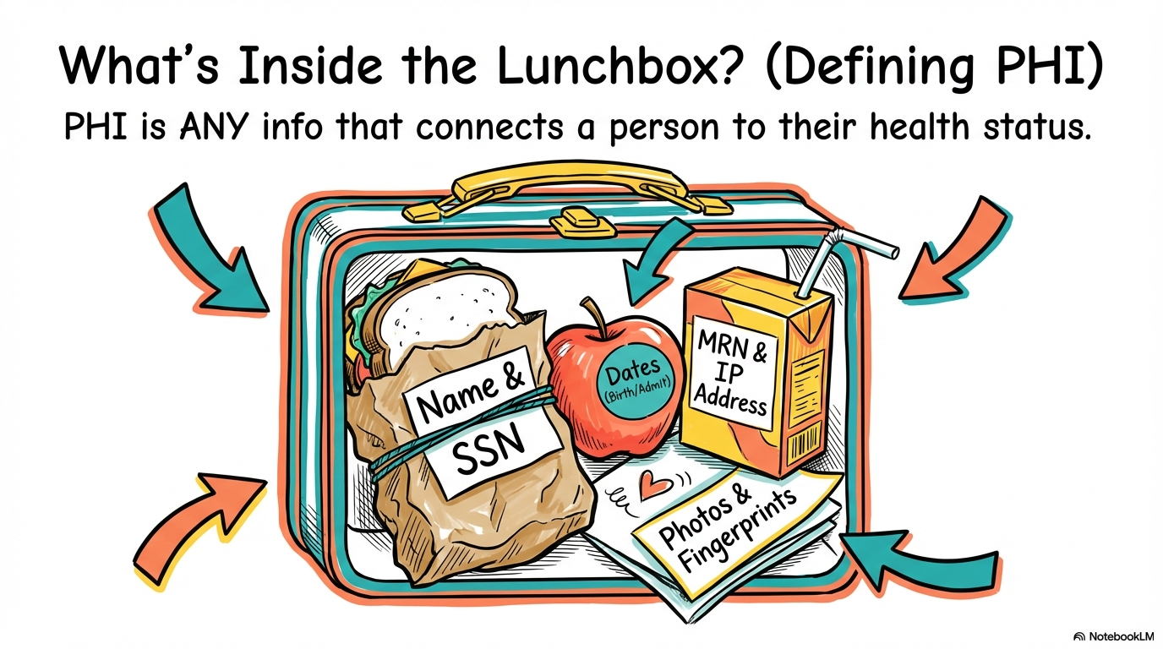
Notes:
So, what exactly are we protecting? Think of it like a lunchbox. P H I, or Protected Health Information, is any info that connects a person to their health status. This includes the obvious stuff like Names and Social Security numbers, but also things like M R N, I P addresses, dates, and even fingerprints!

Slide 5
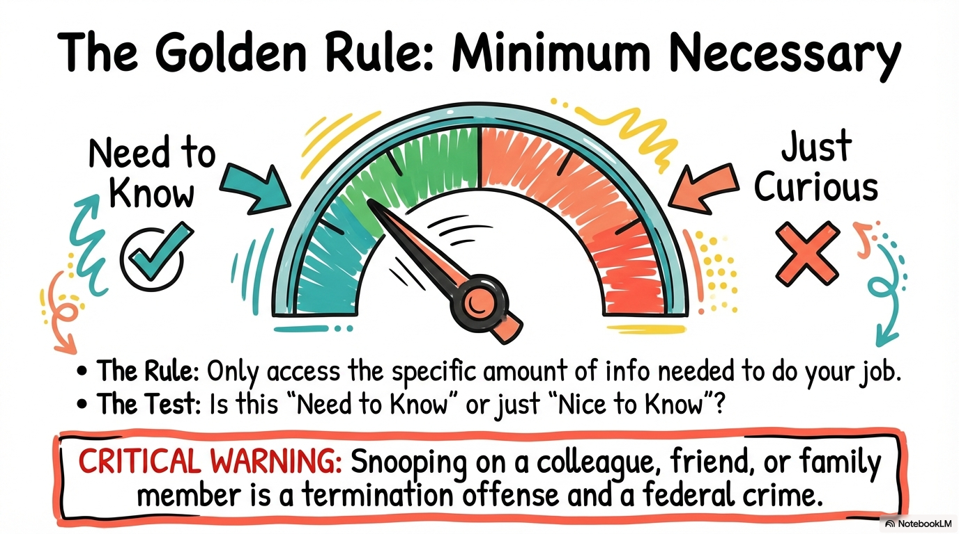
Notes:
Our Golden Rule is simple: Minimum Necessary. Ask yourself: 'Do I really need to know this to do my job, or am I just curious?' A quick warning: snooping on a friend or family member isn't just a slip-up. It's a termination offense and a federal crime. Let’s keep that needle in the green zone!

Slide 6
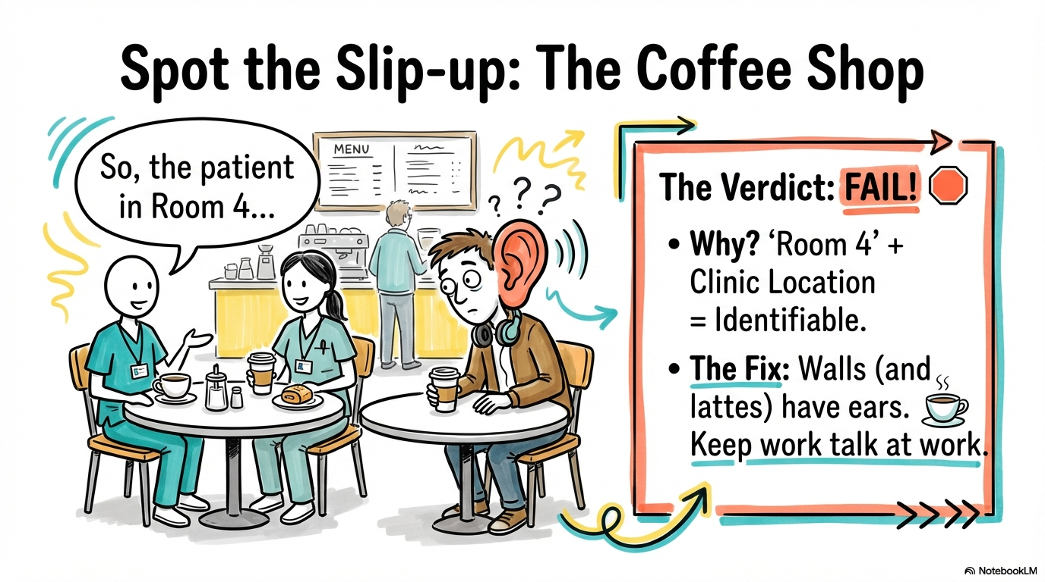
Notes:
Let’s play a quick game. Look at this scene. Two staff members are chatting at a coffee shop about 'the patient in Room 4'. Verdict: FAIL! Why? Because 'Room 4' plus the clinic location makes that patient identifiable. Remember: walls (and lattes) have ears. Keep ‘work-talk’ at work!

Slide 7
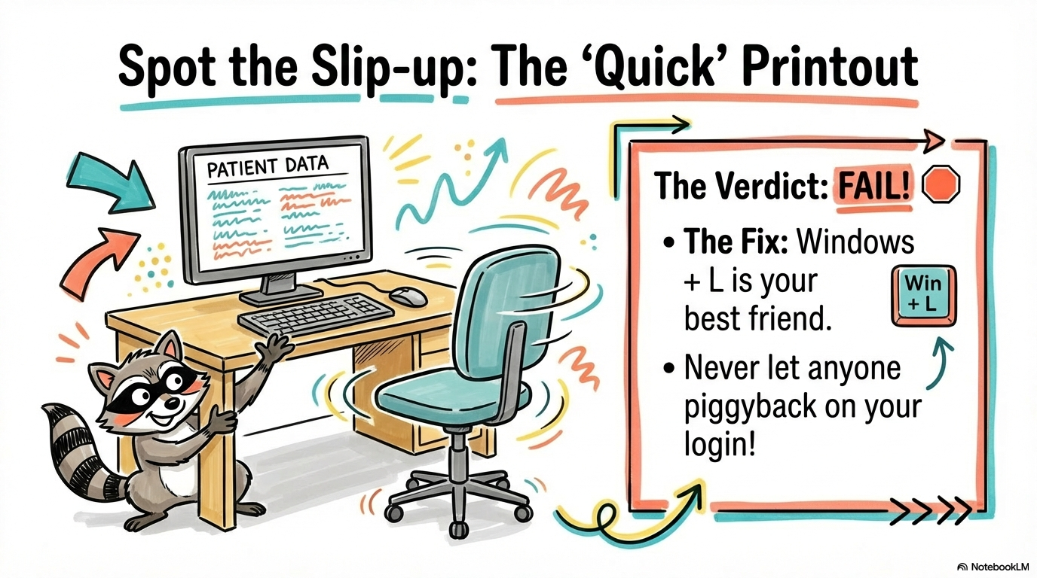
Notes:
Scenario two: You print something out and leave it on your desk while you grab a file. Verdict: FAIL! Even a second is too long. The fix? Windows + L is your best friend. Lock that screen every single time you step away. Never let anyone piggyback on your login!

Slide 8
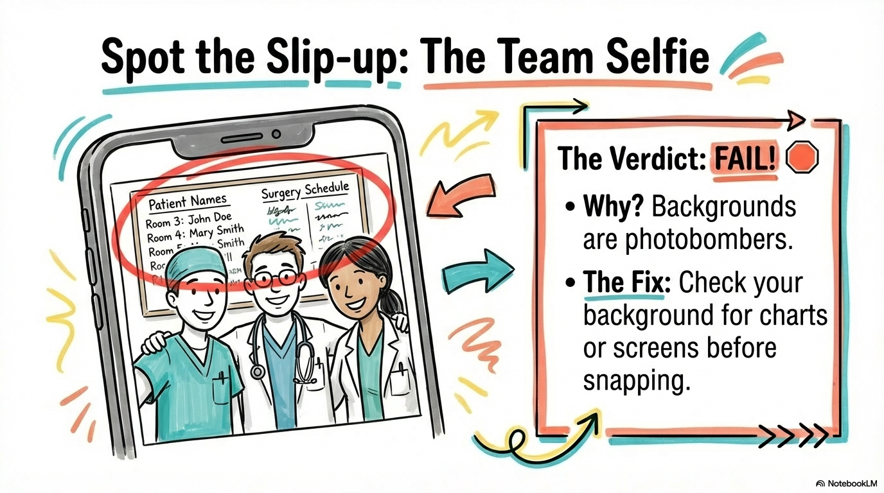
Notes:
Last one. The team selfie! We love the team spirit, but Verdict: FAIL! Check the background. Patient names and surgery schedules are total photobombers. Always double-check behind you before you snap and post.

Slide 9
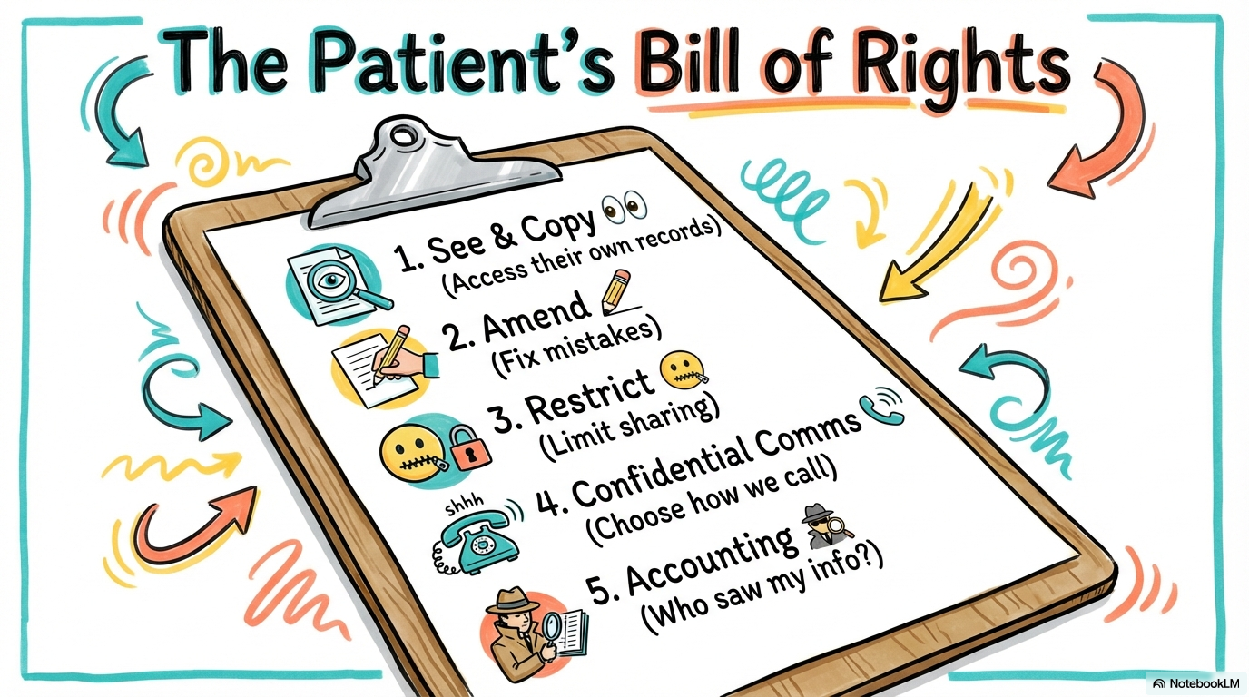
Notes:
Our patients have rights too! They have the right to See & Copy their own records, Amend mistakes, Restrict who we share with, choose Confidential Comms, like how we call them, and get an Accounting of who has seen their info. We are the guardians of these rights.

Slide 10
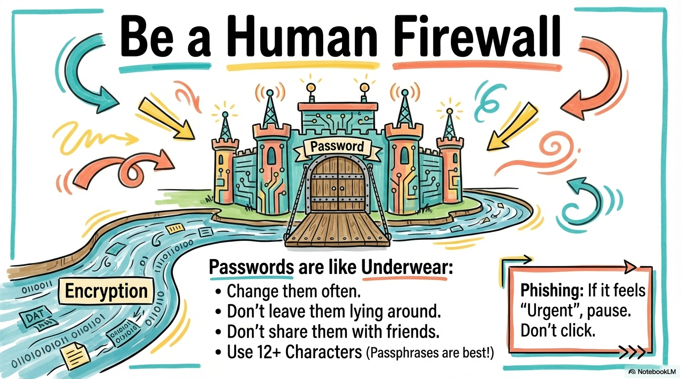
Notes:
You are our most important defense, a Human Firewall. Remember: Passwords are like underwear, change them often, don't leave them lying around, and don't share them with friends! Also, if an email feels 'Urgent' and asks you to click a link. Pause. That's probably phishing.

Slide 11
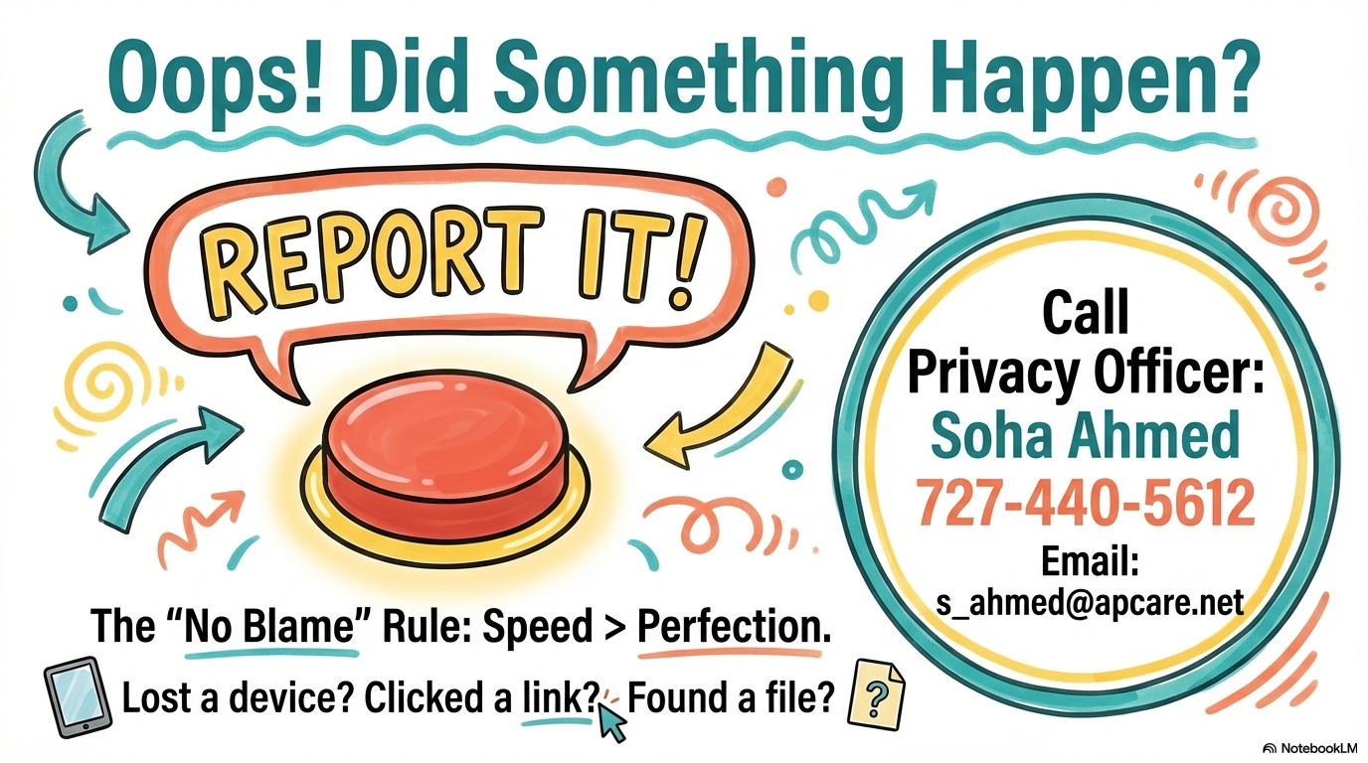



Your Clinic Privacy Official is listed at the top of this video.
Please note down their name and contact information.
Notes:
Mistakes happen. If you lose a device, click a bad link, or find a file you shouldn't have. Report it. We follow a 'No Blame' rule because speed is more important than perfection. Immediately call or email your Privacy Officer, see their info above this video, at the number or email listed.

Slide 12
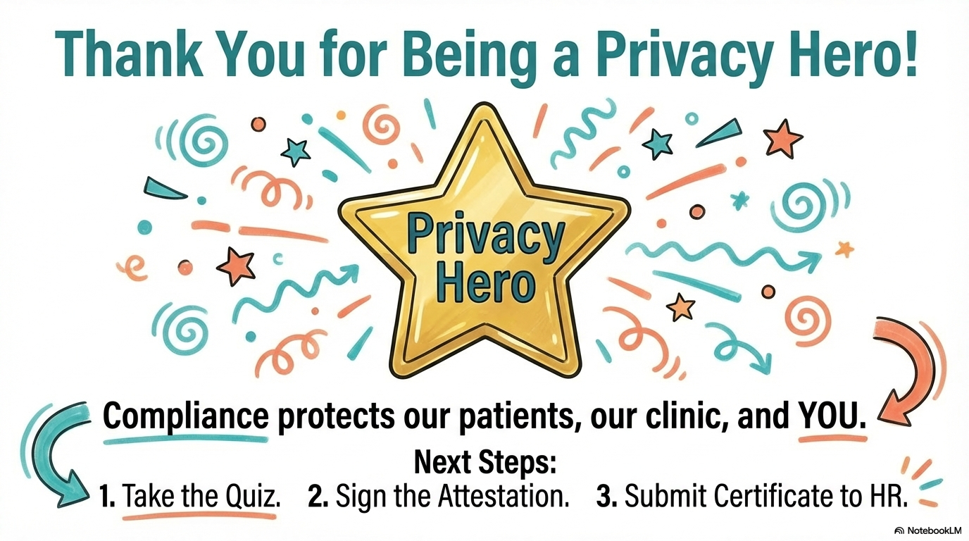
Score >80% and Move to next module.
Notes:
That wraps up our introduction! Thank you for being a Privacy Hero. Remember, compliance protects our patients, our clinic, and YOU. Next up, you’ll need to take the quiz, and you’ll need an 80% or better to move on to Module 2. Good luck!

